Slide 1
NEXATECH
School Operations Platform
School onboarding proposal
A 30 day pilot focused on student records, marks, results, attendance, and controlled school access
Prepared 21 October 2026

Slide 2
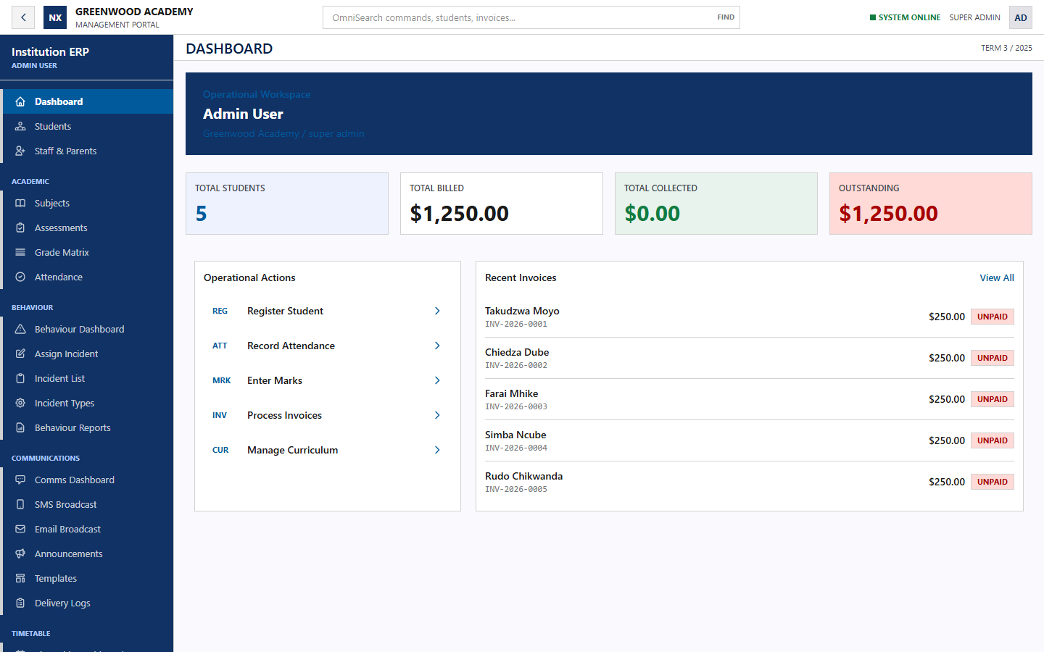
What the system is about
NEXATECH
One connected workspace for routine school operations
Nexatech helps a school capture information once, keep it under controlled access, and retrieve it when staff or families need it.
Faster daily work
Registers, marks, results, invoices, and school records stay in one system.
Clear responsibility
Role based access separates administration, teaching, finance, and parent views.
Reliable records
Validation, audit history, backups, and managed hosting protect the school record.
Synthetic Greenwood Academy demonstration data
02

Slide 3
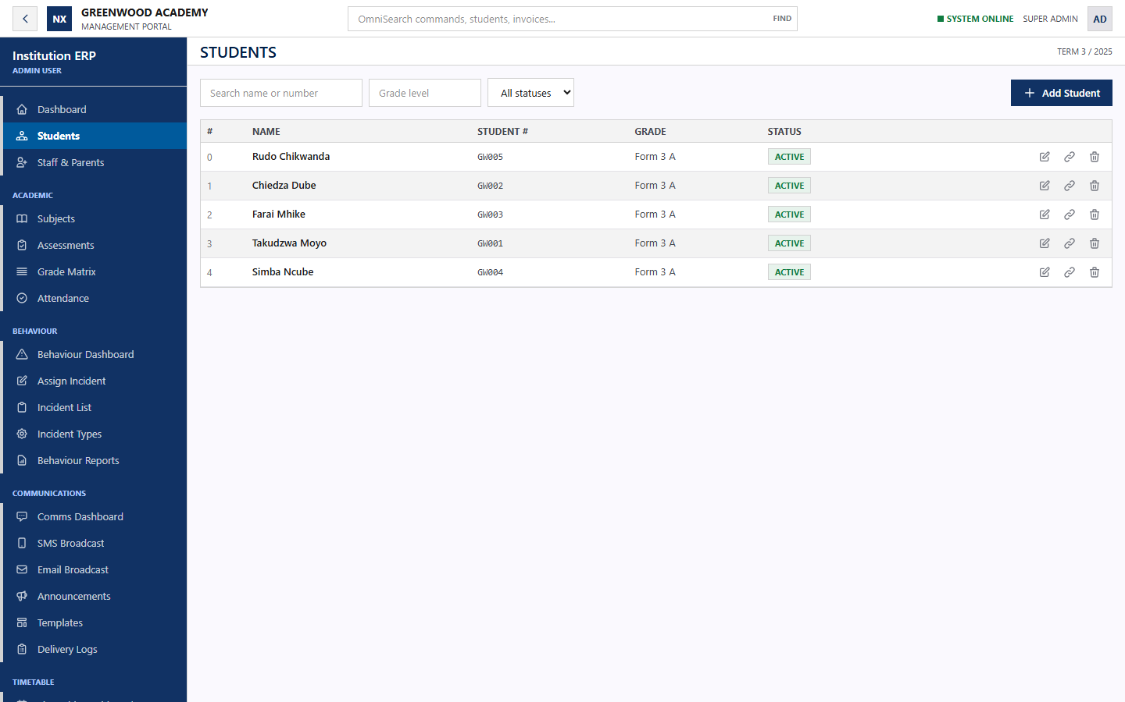
Operational coverage
NEXATECH
The school can begin with academics and extend into the wider platform
Student administration
Searchable learner records, class placement, guardians, and account status.
Academic work
Assessments, grading, marks entry, rankings, report cards, and exports.
School operations
Attendance, finance, timetables, communications, behaviour, and parent access.
Controlled access
Each user sees the records and actions assigned to their role.
03

Slide 4
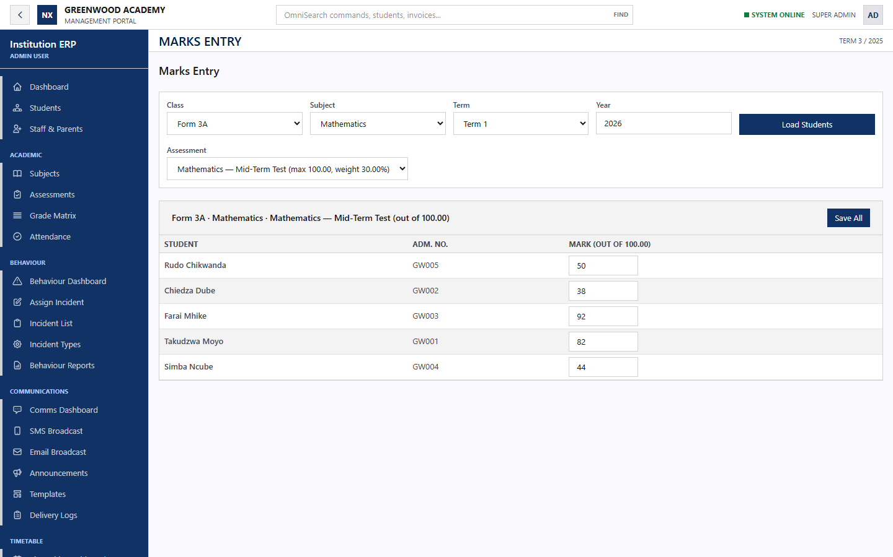
Fast Marks workflow
NEXATECH
The first flagship workflow for the school pilot
Teacher workflow
1 Select the class, subject, term, and assessment
2 Load the correct class roster
3 Enter or update marks in one grid
4 Save the set and retrieve results immediately
Pilot measure
A teacher should complete a 40 learner assessment in under five minutes.
04

Slide 5
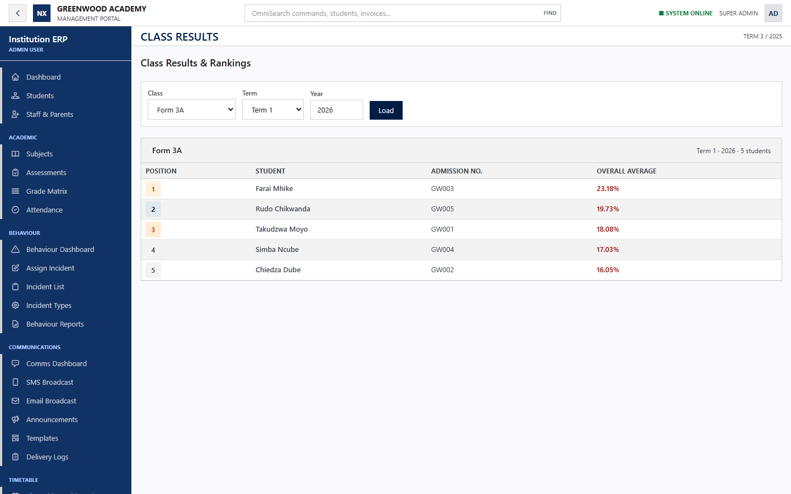
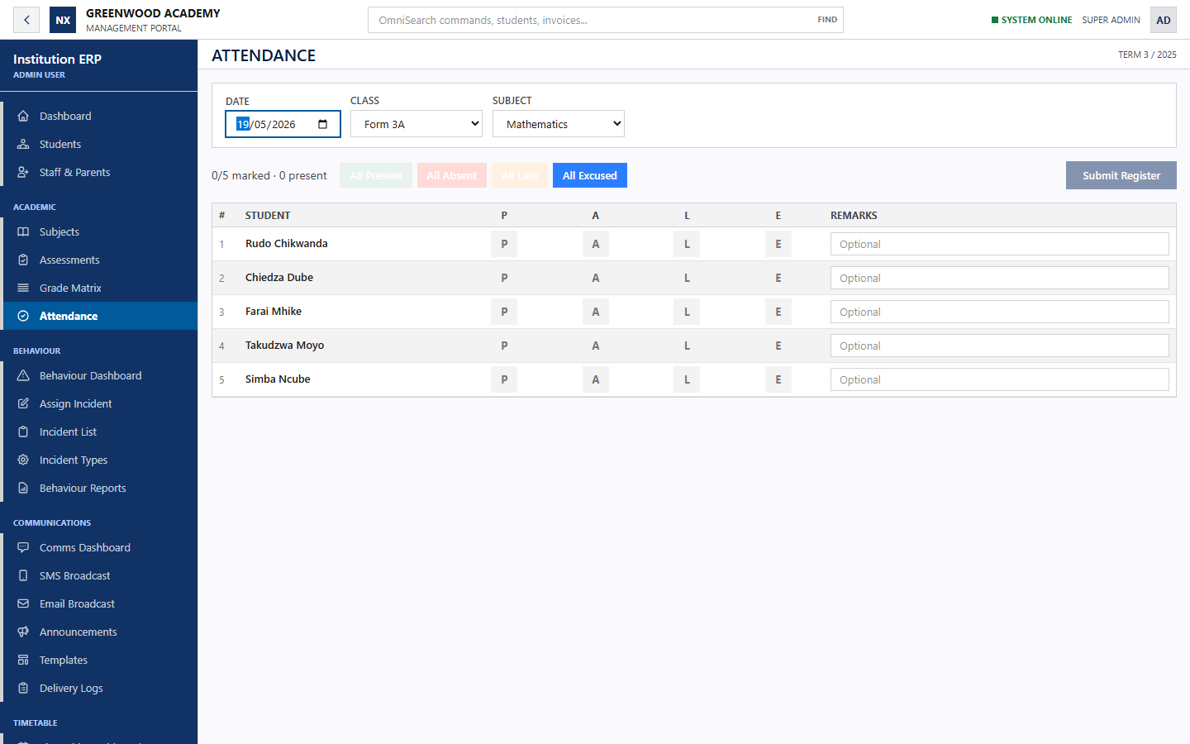
Results and attendance
NEXATECH
The stored record becomes immediately useful to staff
Class results
Attendance register
Authorized staff can retrieve rankings and averages by class, term, and year.
Teachers can open the correct roster and record status with optional remarks.
05

Slide 6
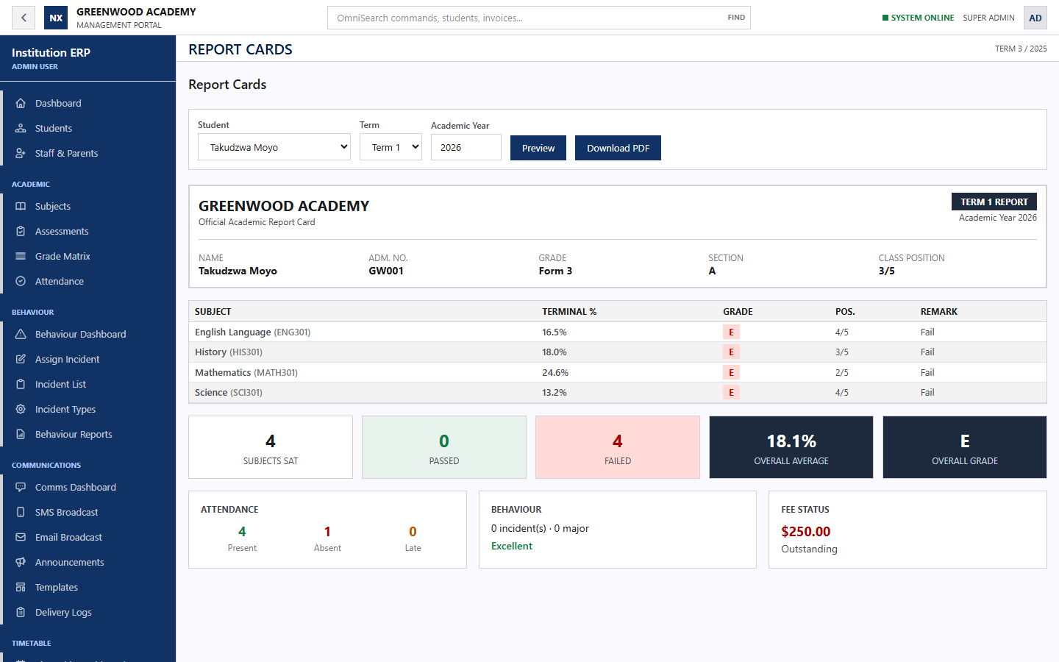
Report cards and school records
NEXATECH
One view combines academic outcomes with the wider learner record
A useful report
Academic results
Subject percentages, grades, remarks, positions, and overall average.
Whole record
Attendance, behaviour standing, and fee status appear beside the results.
Distribution
Authorized staff preview the report and download a PDF for approved use.
Synthetic demonstration record
06

Slide 7
Faster data intake
NEXATECH
Capture methods can match the records a school already has
Available now
Pilot configuration
Optional extension
Keyboard entry and spreadsheet column paste
Roster based marks capture with validation and autosave
Bulk grade API with duplicate safe updates
CSV or spreadsheet upload for learners, guardians, classes, and marks
Column mapping, row validation, error file, and approval before import
Reusable intake templates for each school
OCR assisted capture from scanned forms or photographed mark sheets
Human review of extracted fields before anything reaches the school record
Quoted as custom work after sample documents are tested
Every import should stage data first, explain rejected rows, and require confirmation before committing records.
07

Slide 8
Information access and responsibility
NEXATECH
Authorized people can reach the records they need from any connected device
The school controls access by role, school context, and assigned responsibility.
Administrator
School setup, learners, users, reports, finance, communications, and configuration.
Teacher
Assigned classes, attendance, assessments, marks, results, and approved notices.
The browser based workspace supports office, classroom, and parent access without sharing one common account.
Parent
Read only access to the linked child, reports, fees, timetable, and announcements.
Access controls remain part of the pilot test, including tenant separation, role permissions, session security, and audit history.
Invoices, payments, cashbook, approved expenses, and finance reports.
Finance staff
08

Slide 9
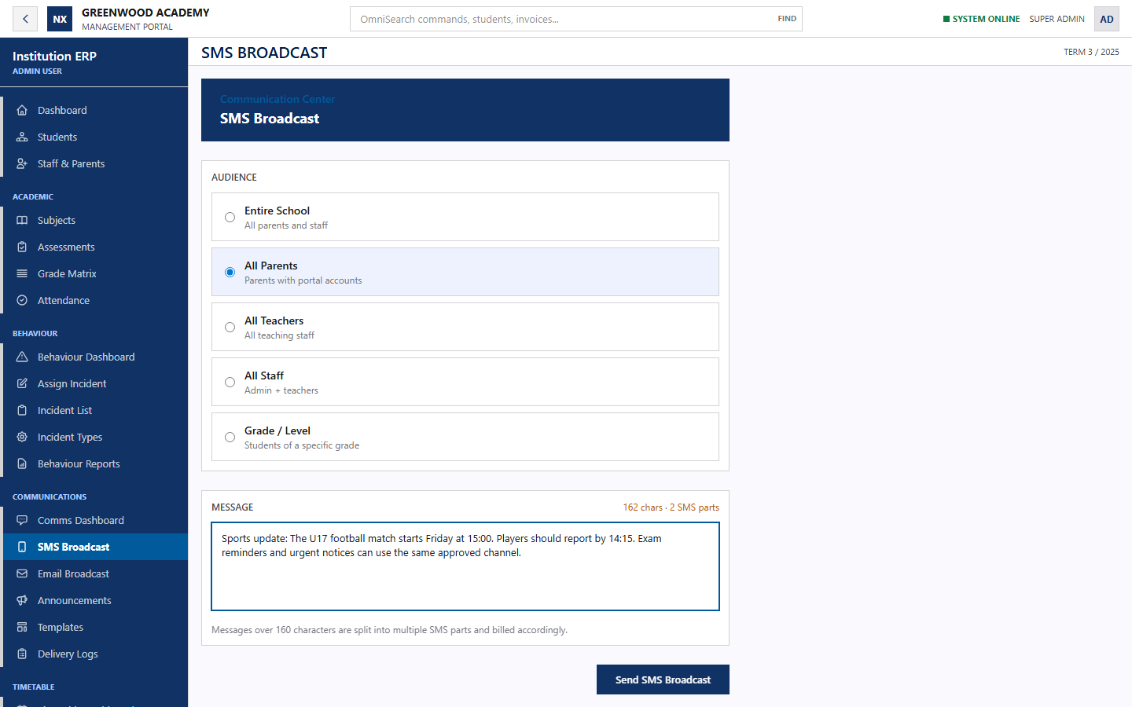
School communications
NEXATECH
Notices can reach the correct audience through approved channels
Available in the system
SMS and email broadcasts
Audience selection by school role or grade
Reusable templates and scheduled messages
Delivery logs, failures, and retry visibility
Typical notices
Exam reminders, sports fixtures, transport changes, meeting notices, payment updates, and urgent alerts.
WhatsApp Business can be added as a managed connector after provider approval, templates, consent rules, and costs are agreed.
09

Slide 10
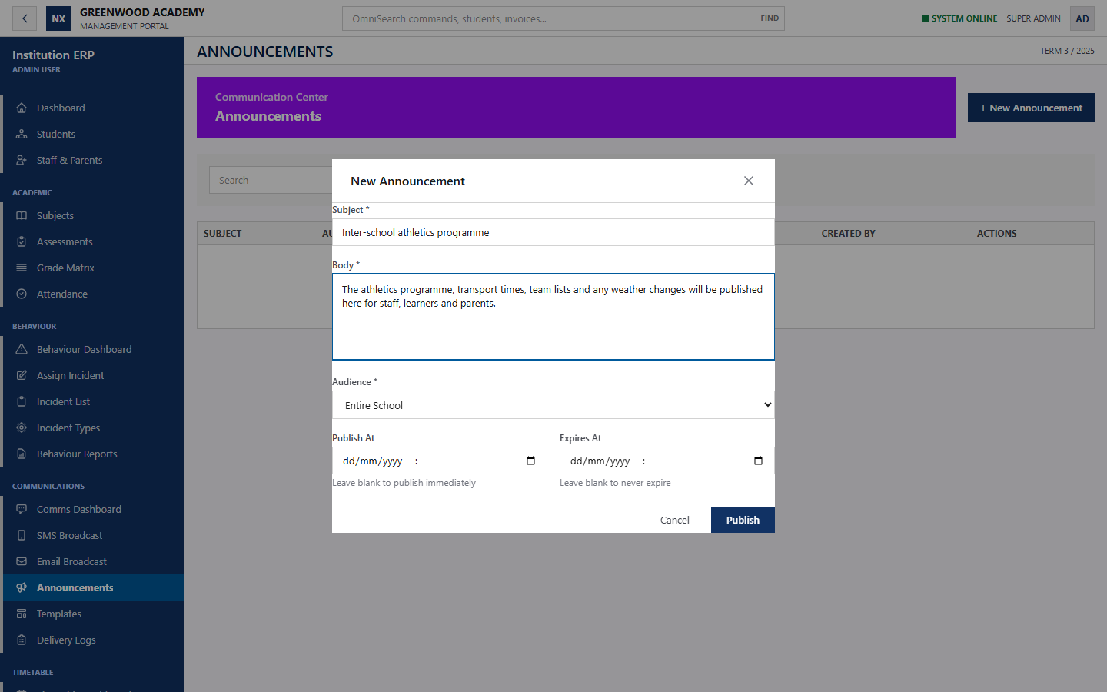
School news and updates
NEXATECH
An internal news space can grow into a controlled public information channel
Current announcement workspace
Staff publish notices for the whole school, parents, teachers, staff, or a selected grade. Each item can publish immediately, follow a schedule, or expire automatically.
Public news option
A school approved public page can share sports results, event updates, achievements, calendars, notices, and selected documents. Private learner information stays inside authenticated views.
Draft shown with synthetic demonstration content and not published.
10

Slide 11
Configuration for each school
NEXATECH
The pilot fixes the first workflow while preserving room for later modules
Roles and permissions
Named responsibilities, approval rights, parent visibility, and module access.
Academic rules
Terms, subjects, grading bands, assessment weights, report layouts, and class structures.
Data intake
Import templates, required fields, validation rules, archive mapping, and optional OCR review.
Communications
Sender identity, templates, audiences, schedules, SMS and email providers, then WhatsApp if approved.
School presence
Branding, domain, parent portal, internal news, and an optional public updates page.
Integrations
Managed API access, payments, exports, and approved connections to existing services.
The implementation plan should enable modules in phases, with a price, owner, test, and acceptance condition for each phase.
11

Slide 12
Proposed 30 day pilot
NEXATECH
A controlled evaluation using agreed data and named users
Week 1
Prepare
Confirm scope, clean one data file, configure users and academic settings.
Week 2
Train
Train the administrator and teachers on the agreed workflows.
Week 3
Use
Run student records, marks, results, and attendance with support.
Week 4
Review
Measure time saved, corrections, adoption, and the next rollout decision.
Pilot boundary
Up to 500 active learners, one administrator, up to 10 teachers, and synthetic or school approved data only.
12

Slide 13
Recommended pilot budget
NEXATECH
Starting proposal in US dollars
Item | Included | Price
30 day pilot | Configuration, one clean import, administrator and teacher training, hosting, database, backups, and support | US$299 once
Academic plan | Up to 500 learners, student records, Fast Marks, assessments, results, report cards, attendance, and exports | US$179 / month
Operations plan | Academic plan plus finance, timetable, communications, behaviour, parent portal, and priority support | US$299 / month
Public API access | One documented integration, scoped credentials, logs, standard rate limit, and key rotation support | US$49 / month
Dedicated database | Dedicated managed database resources where the school requires separation beyond the standard tenant design | From US$75 / month
Pilot fee credit
If the school signs the Academic or Operations plan within 14 days of the pilot review, apply the US$299 pilot fee toward the standard US$350 onboarding charge.
SMS, email, payment provider fees, complex historical data cleaning, taxes, and custom integrations remain separate.
13

Slide 14
Technical foundation
Current implementation and hosting model
Application
Data and operations
React 19, Vite 8, Tailwind CSS 4, Axios, Laravel 13, PHP 8.4, Sanctum, DOMPDF, and Paynow SDK
Managed MySQL, Redis queues and cache, encrypted sessions, backups, scheduler, worker, logs, and health checks
Hosting
Next step
Docker deployment on Railway with separate web, worker, scheduler, MySQL, and Redis services behind HTTPS
Agree the pilot scope, nominate the school lead, approve the data set, and schedule the demonstration.
Nexatech School Operations Platform
14

